Slide 1
LESSON TEN
TOPICS: HOW TO MAKE THE TARGET FLASH WHEN SOMEONE CLICKS ON IT.

Slide 2
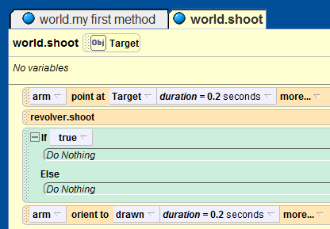
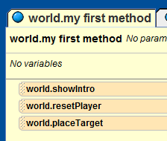
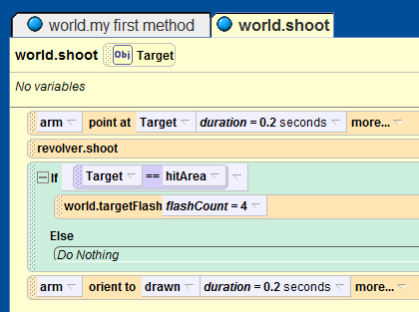
Step 1: Make a Target Flash when Clicked on
Drag an if / else statement into the “world.shoot” method after the line “revolver.shoot”. Set it’s default value to true.
Drag the “Target” parameter on top of the “true” value in the “if” statement. From the popup menu, select “== Target -> hitArea”.
Add a call to the “world.targetFlash” method, and choose an input value of 4.
Delete the call to “world.targetFlash” from “world.my first method.”

Slide 3
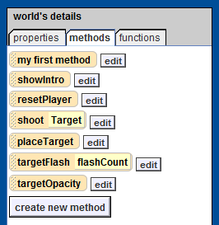
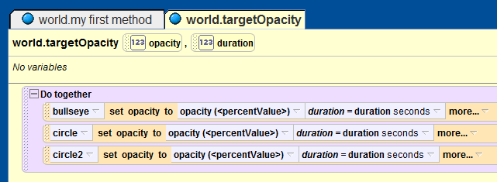
Step 2: Functionally Set the Target’s Opacity
Create a new method called “targetOpacity” for the world object.
Create two number-type parameters “opacity” and “duration” for the targetOpacity method.
Recreate the first “Do together” statement from the world.targetFlash method inside the targetOpacity function, but with the opacity set to the “opacity” parameter and the duration set to the “duration” parameter.
Notes:
QUESTION: Why do we want to move the opacity functions from the targetFlash function into the targetOpacity function?
ANSWER: This is an important part of code organization and reuse. Code that is frequently used in many different locations of a larger program should be organized into a function so as to enable it to be called by other functions. Since we will want to set the target opacity later during game startup, and latter while we are moving the target around the scene we will want to be able to reuse the target opacity code in many different locations.
QUESTION: WHY do we want to organize code this way?
ANSWER: To be consistent and lazy. It takes much less effort to update a function than many different code locations. Also, many instances of a piece of code, instead of many function calls to the same piece of code, will increase the likelihood that we will introduce a bug into our program.

Slide 4
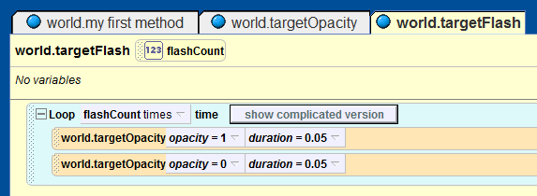
Step 3: Update the targetFlash Function
Replace the two “do together” statements from the “world.targetFlash” method with two calls to the “world.targetOpacity” function. Set the values for the first call to opacity = 1,
duration = 0.05, and the values for the second call to opacity = 0, and duration = 0.05.

Slide 5
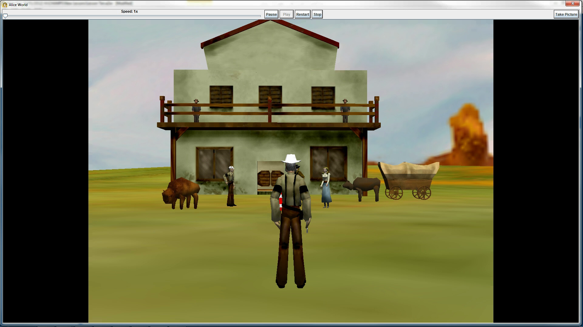
Final Scene

